Slide 1
Strategic Capacity Planning for Products and Services Chapter # 4

Slide 2
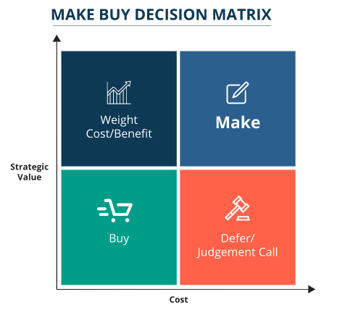
High strategic value; high cost — Make
High strategic value; low cost — Weigh Cost/Benefit
Low strategic value, high cost — Defer or Judgment Call
Low strategic value, low cost — Buy

Slide 3
Capacity Planning
 Capacity refers to an upper limit or ceiling on the load that an operating unit can handle.
 The load might be in terms of the number of physical units produced (e.g., bicycles assembled per hour) or the number of services performed (e.g., computers upgraded per hour).
 The operating unit might be a plant, department, machine, store, or worker.
 Capacity needs include equipment, space, and employee skills.

Slide 4
Capacity Planning
 The key questions in capacity planning are the following:
What kind of capacity is needed?
How much is needed to match demand?
When is it needed?

Slide 5
Capacity Decisions are Strategic
For several reasons, capacity decisions are among the most fundamental of all the design decisions that managers must make.
In fact, capacity decisions can be critical for an organization.

Slide 6
Capacity Decisions are Strategic
Capacity decisions have a real impact on the ability of the organization to meet future demands for products and services; capacity essentially limits the rate of output possible.
Capacity decisions affect operating costs. Ideally, capacity and demand requirements will be matched, which will tend to minimize operating costs.
Capacity is usually a major determinant of the initial cost.
Typically, the greater the capacity of a productive unit, the greater its cost.

Slide 7
Capacity Decisions are Strategic
Capacity decisions often involve a long-term commitment of resources, and once they are implemented, those decisions may be difficult or impossible to modify without incurring major costs.
Capacity decisions can affect competitiveness. If a firm has excess capacity, or can quickly add capacity, that fact may serve as a barrier to entry by other firms. Then, too, capacity can affect delivery speed, which can be a competitive advantage.

Slide 8
Capacity Decisions are Strategic
Capacity affects the ease of management; having appropriate capacity makes management easier than when capacity is mismatched.
Globalization has increased the importance and the complexity of capacity decisions. Far-flung supply chains and distant markets add to the uncertainty about capacity needs.

Slide 9
Capacity Decisions are Strategic
Because capacity decisions often involve substantial financial and other resources, it is necessary to plan for them far in advance.
For example, it may take years for a new power-generating plant to be constructed and become operational.
However, this increases the risk that the designated amount of capacity will not match actual demand or reserve requirements when the capacity becomes available.

Slide 10
DEFINING AND MEASURING CAPACITY

Slide 11
Useful Definitions of Capacity
 Design capacity: The maximum output rate or service capacity an operation, process, or facility is designed for.
 Effective capacity: Design capacity minus allowances such as personal time, preventive maintenance, and scrap.
The design capacity is the maximum rate of output achieved under ideal conditions.
Effective capacity is always less than design capacity, owing to the realities of changing product mix, the need for periodic maintenance of equipment, lunch breaks, coffee breaks, problems in scheduling and balancing operations, and similar circumstances.

Slide 12
Useful Definitions of Capacity
 Actual output cannot exceed effective capacity and is often less because of machine breakdowns, absenteeism, shortages of materials, and quality problems, as well as factors that are outside the control of the operations managers.

Slide 13
Useful Definitions of Capacity
These different measures of capacity are useful in defining two measures of system effectiveness: efficiency and utilization.
 Efficiency is the ratio of actual output to effective capacity.
 Capacity utilization is the ratio of actual output to design capacity.

Slide 14
Computing Capacity and Utilization
Efficiency = Actual Output × 100%
Effective Capacity
Utilization = Actual Output × 100%
Design Capacity
Both measures are expressed as percentages.

Slide 15
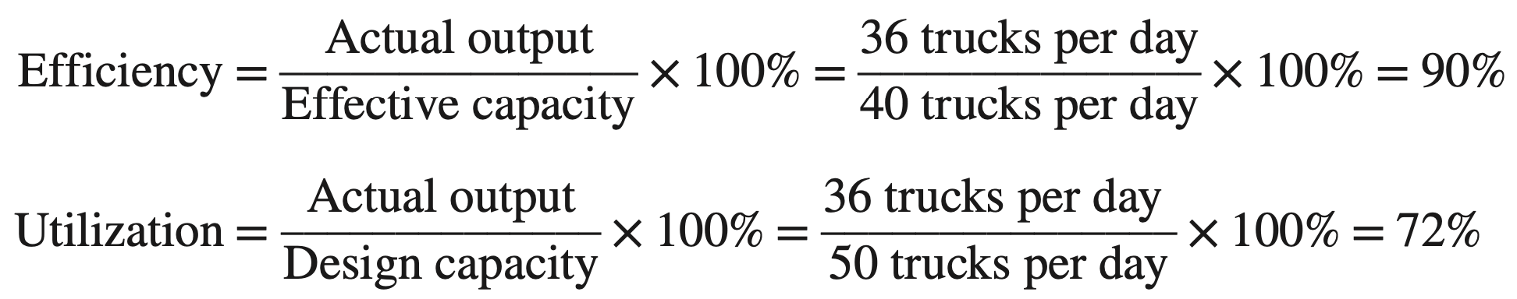
Computing Capacity and Utilization
Given the following information, compute the efficiency and utilization of the vehicle repair department:
Design capacity = 50 trucks per day
Effective capacity = 40 trucks per day
Actual output = 36 trucks per day

Slide 16
Computing Capacity and Utilization
 Compared to the effective capacity of 40 units per day, 36 units per day looks pretty good.
 However, compared to the design capacity of 50 units per day, 36 units per day is much less impressive, although probably more meaningful.
 Because effective capacity acts as a lid on actual output, the real key to improving capacity utilization is to increase effective capacity by correcting quality problems, maintaining equipment in good operating condition, fully training employees, and improving bottleneck operations that constrain output.
 Eliminating waste, which is a key aspect of a lean operation, can also help to improve effective capacity.

Slide 17
Determinants of Effective Capacity

Slide 18
Determinants of Effective Capacity
Facilities
The design of facilities, including size and provision for expansion, is key.
Locational factors, such as transportation costs, distance to market, labor supply, energy sources, and room for expansion, are also important.
Likewise, the layout of the work area often determines how smoothly work can be performed, and environmental factors such as heating, lighting, and ventilation also play a significant role in determining whether personnel can perform effectively or whether they must struggle to overcome poor design characteristics.

Slide 19
Determinants of Effective Capacity
Product and Service Factors
Product or service design can have a tremendous influence on capacity.
For example, when items are similar, the ability of the system to produce those items is generally much greater than when successive items differ.
Thus, a restaurant that offers a limited menu can usually prepare and serve meals at a faster rate than a restaurant with an extensive menu.
Generally speaking, the more uniform the output, the more opportunities there are for the standardization of methods and materials, which leads to greater capacity.

Slide 20
Determinants of Effective Capacity
Process Factors
instance, if the quality of output does not meet standards, the rate of output will be slowed by the need for inspection and rework activities. Productivity also affects capacity.
Process improvements that increase quality and productivity can result in increased capacity.
Also, if multiple products or multiple services are processed in batches, the time to change equipment settings must be taken into account.
The quantity capability of a process is an obvious determinant of capacity.
A more subtle determinant is the influence of output quality.

Slide 21
Determinants of Effective Capacity
Human Factors
The tasks that make up a job, the variety of activities involved, and the training, skill, and experience required to perform a job all have an impact on the potential and actual output.
In addition, employee motivation has a very basic relationship to capacity, as do absenteeism and labor turnover.
Policy Factors
Management policy can affect capacity by allowing or not allowing capacity options such as overtime or second or third shifts.

Slide 22
Determinants of Effective Capacity
Operational Factors
Scheduling problems may occur when an organization has differences in equipment capabilities among alternative pieces of equipment or differences in job requirements.
Inventory stocking decisions, late deliveries, purchasing requirements, acceptability of purchased materials and parts, and quality inspection and control procedures also can have an impact on effective capacity.
Inventory shortages of even one component of an assembled item (e.g., computers, refrigerators, automobiles) can cause a temporary halt to assembly operations until the components become available.
This can have a major impact on effective capacity.
Thus, insufficient capacity in one area can affect overall capacity.

Slide 23
Determinants of Effective Capacity
Supply Chain Factors
Supply chain factors must be considered in capacity planning if substantial capacity changes are involved.
Key questions include:
What impact will the changes have on suppliers, warehousing, transportation, and distributors?
If capacity is increased, will these elements of the supply chain be able to handle the increase?
Conversely, if capacity is to be decreased, what impact will the loss of business have on these elements of the supply chain?

Slide 24
Determinants of Effective Capacity
External Factors
Product standards, especially minimum quality and performance standards, can restrict management’s options for increasing and using capacity.
Thus, pollution standards on products and equipment often reduce effective capacity, as does paperwork required by government regulatory agencies by engaging employees in non-productive activities.

Slide 25
Calculating Processing Requirements

Slide 26
Calculating Processing Requirements
 A necessary piece of information is the capacity requirements of products that will be processed.
 To get this information, one must have reasonably accurate demand forecasts for each product and know the standard processing time per unit for each product, the number of work days per year, and the number of shifts that will be used.

Slide 27
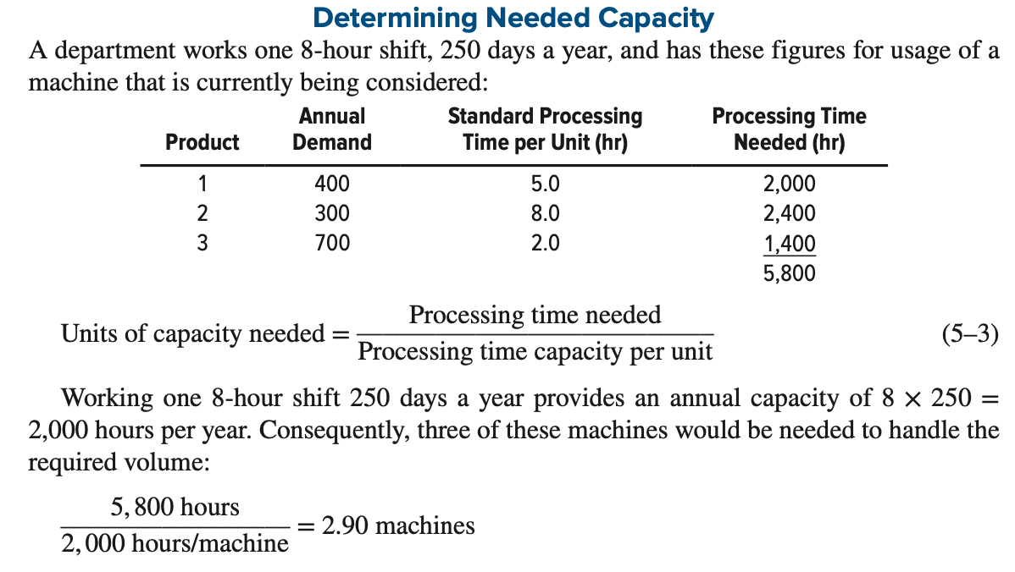
Determining Needed Capacity

Slide 28
Evaluating Alternatives

Slide 29
Evaluating Alternatives
 A number of techniques are useful for evaluating capacity alternatives from an economic standpoint.
 Some of the more common are cost–volume analysis, financial analysis, decision theory, and waiting-line analysis.

Slide 30
Cost-Volume Analysis
❐ Cost–volume analysis focuses on relationships between cost, revenue, and volume of output.
 The purpose of cost–volume analysis is to estimate the income of an organization under different operating conditions.
 It is particularly useful as a tool for comparing capacity alternatives.

Slide 31
Cost-Volume Analysis
 The use of the technique requires the identification of all costs related to the production of a given product.
 These costs are then designated as fixed costs or variable costs.
 Fixed costs tend to remain constant regardless of the volume of output.
 Examples include rental costs, property taxes, equipment costs, heating and cooling expenses, and certain administrative costs.

Slide 32
Cost-Volume Analysis
 Variable costs vary directly with volume of output.
 The major components of variable costs are generally materials and labor costs.
 We will assume that variable cost per unit remains the same regardless of volume of output, and that all output can be sold.

Slide 33
Cost-Volume Analysis
 The total cost associated with a given volume of output is equal to the sum of the fixed cost and the variable cost per unit times volume:
TC = FC + VC
VC = Q × v
where v = variable cost per unit

Slide 34
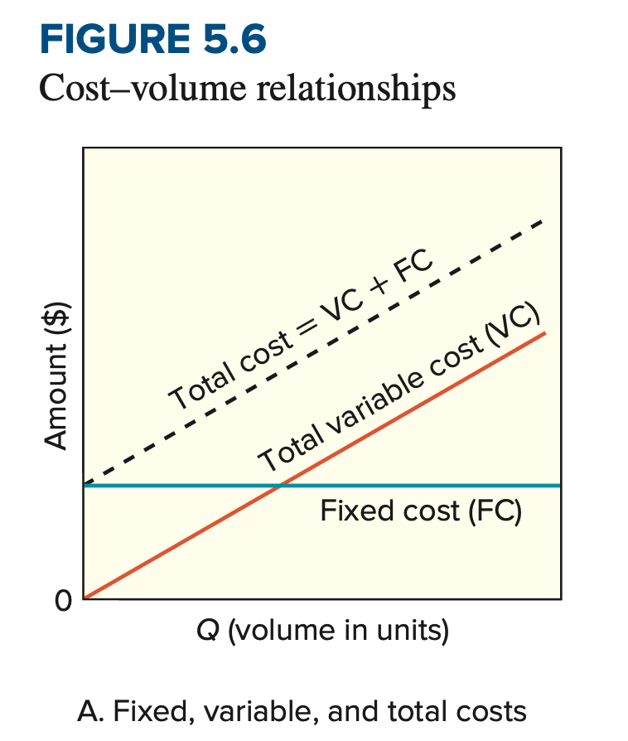
Cost-Volume Analysis
 Figure 5.6A shows the relationship between the volume of output and fixed costs, total variable costs, and total (fixed plus variable) costs.

Slide 35
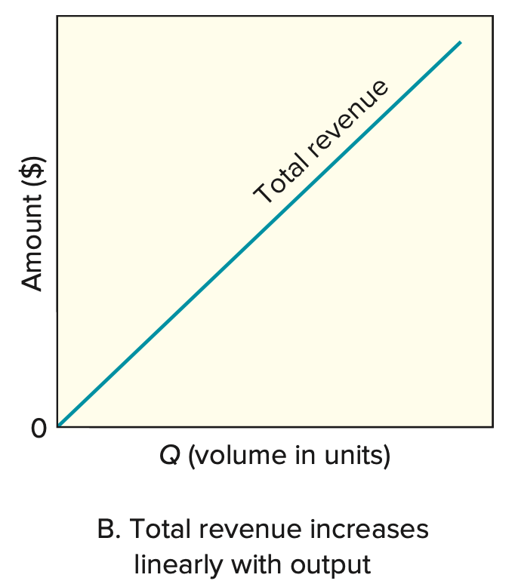
Cost-Volume Analysis
 Revenue per unit, like variable cost per unit, is assumed to be the same regardless of the quantity of output.
 Total revenue will have a linear relationship to output, as illustrated in Figure 5.6B.
 The total revenue associated with a given quantity of output, Q, is
TR = R × Q

Slide 36
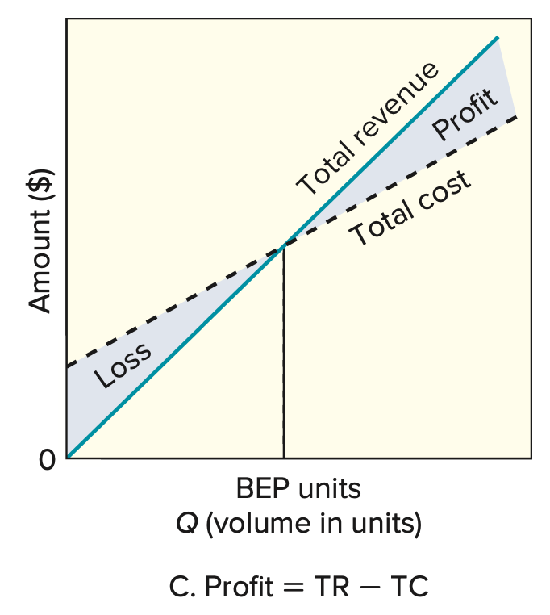
Cost-Volume Analysis
 Figure 5.6C describes the relationship between profit - which is the difference between total revenue and total (i.e., fixed plus variable) cost and volume of output.
 The volume at which total cost and total revenue are equal is referred to as the break-even point (BEP).
 When volume is less than the break-even point, there is a loss; when the volume is greater than the break-even point, there is a profit.
 The greater the deviation from this point, the greater the profit or loss.

Slide 37
Cost-Volume Analysis
 Figure shows the total profit or loss relative to the break-even point.
 Figure can be obtained from Figure 5.6C by drawing a horizontal line through the point where the total cost and total revenue lines intersect.
 Total profit can be computed using the formula
P = TR − TC = R × Q − (FC + v × Q)
Rearranging terms, we have
P = Q(R − v) − FC
The difference between revenue per unit and variable cost per unit,
R − v, is known as the contribution margin.

Slide 38
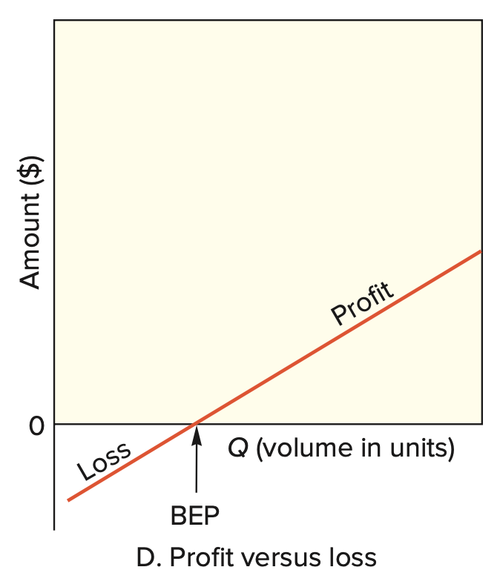
Cost-Volume Analysis
The required volume, Q, needed to generate a specified profit is
Q = P + FC
R−v
A special case of this is the volume of output needed for total revenue to equal total cost.
This is the break-even point, computed using the formula
Q_{BEP} = FC
R−v

Slide 39
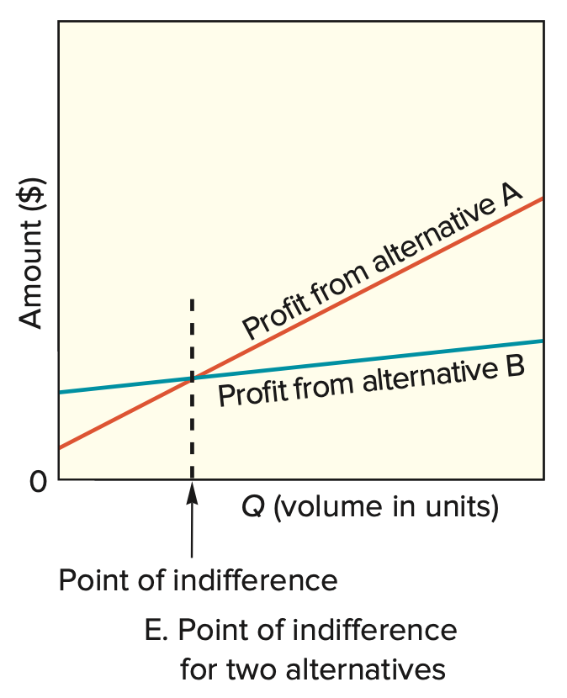
Cost-Volume Analysis
Different alternatives can be compared by plotting the profit lines for the alternatives, as shown.
The figure illustrates the concept of an indifference point: the quantity at which a decision maker would be indifferent between two competing alternatives.
In this illustration, a quantity less than the point of indifference would favor choosing alternative B because its profit is higher in that range, while a quantity greater than the point of indifference would favor choosing alternative A.

Slide 40
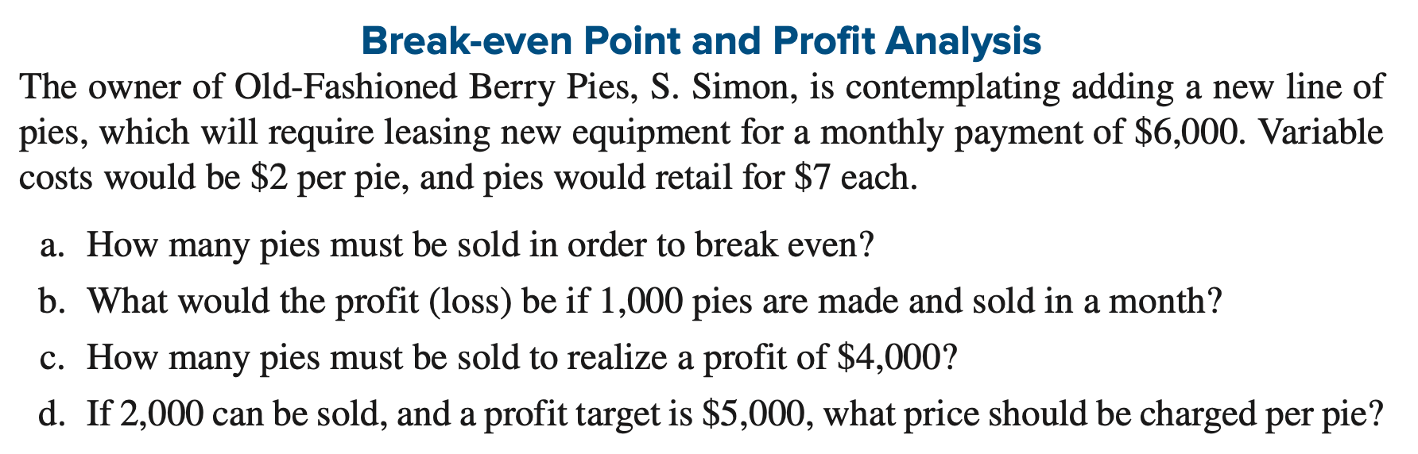
Cost-Volume Analysis

Slide 41
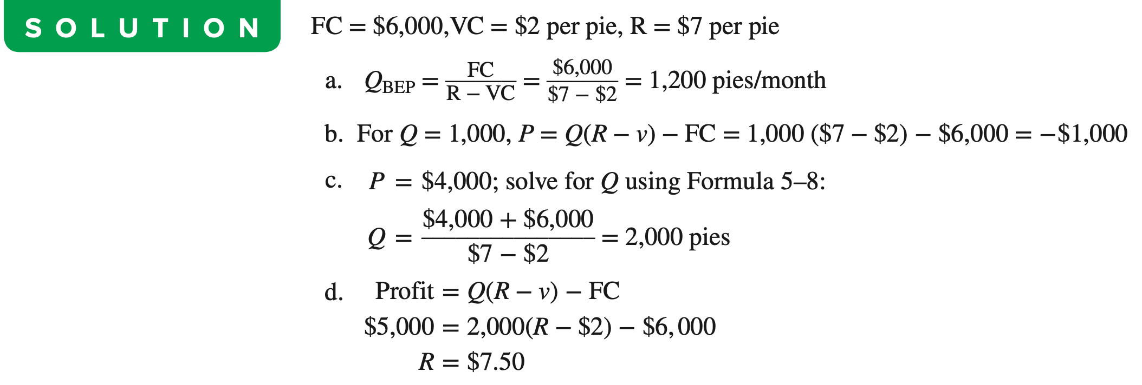
Cost-Volume Analysis

Slide 42
Do it In-house or Outsource It?

Slide 43
Inhouse production or outsource
Inhouse production
Fixed cost (FC): (purchase equipment, facility, etc.)
Variable cost (VC): (material cost, energy cost associated with products)
Quantity of the products (Q)
If per unit variable cost is (v), Total variable cost (VC) = v x Q
Total cost for inhouse production,
(TC-1) = FC + VC = FC + v(Q)
For outsourcing
Per unit product price offered by supplier = R
Total cost for purchasing the product (TC-2)= R x Q
At Q0, TC-1 = TC-2, so cost for inhouse production and outsourcing are same.
So, FC + v(Q0) = R(Q0)
Q0 = FC/(R-v)
TC-2
TC-1
Q1
Qo
Q2
At, Q1: TC (production)> TC (outsource)
Q2: TC (production)< TC (outsource)
So, if Q>Q0, better to outsource

Slide 44
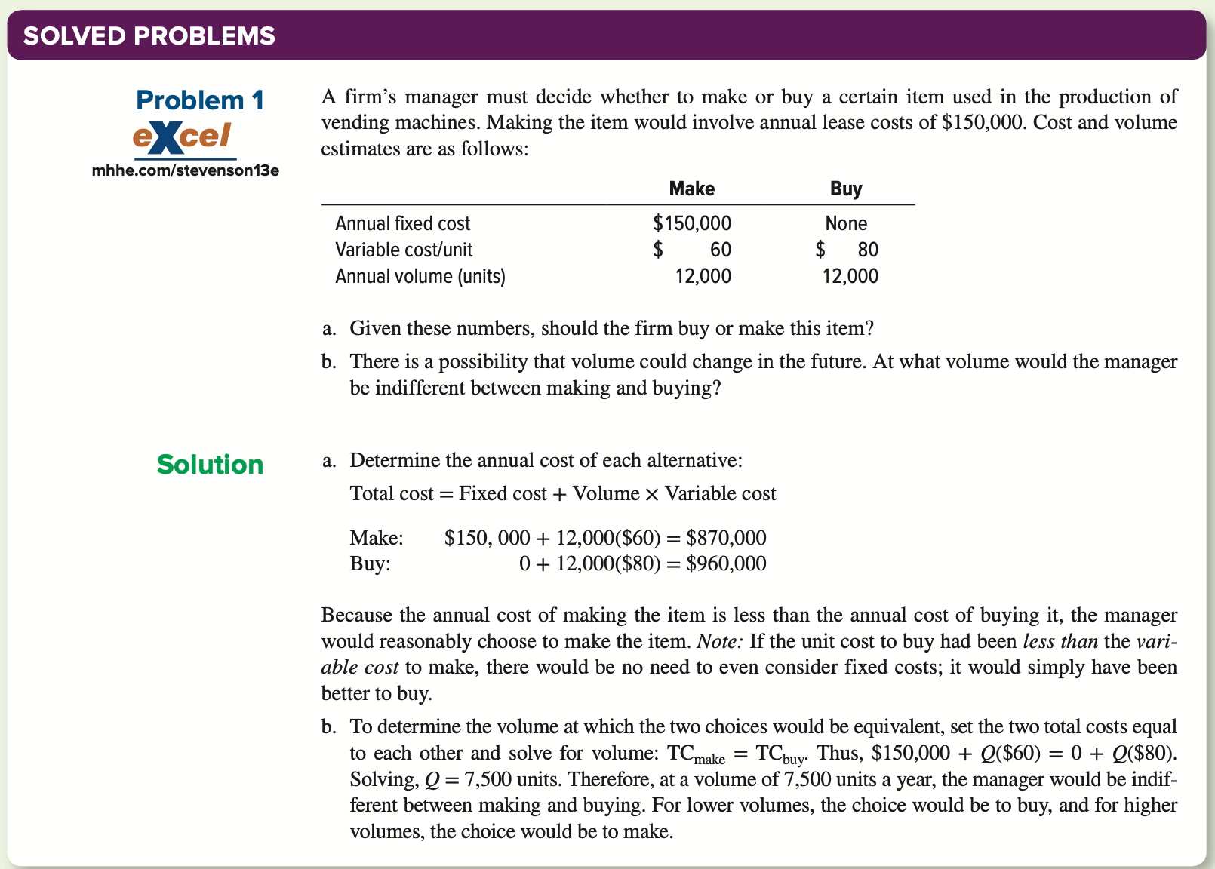
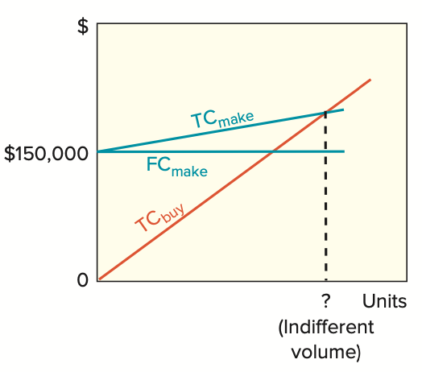

Slide 45
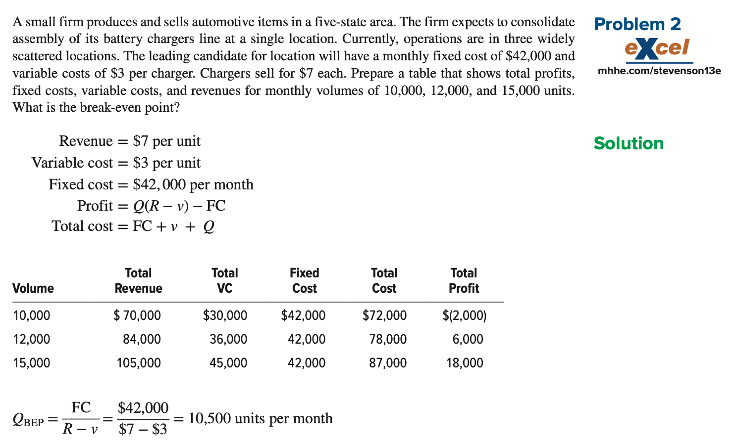
Total cost: FC+V(Q)

Slide 46
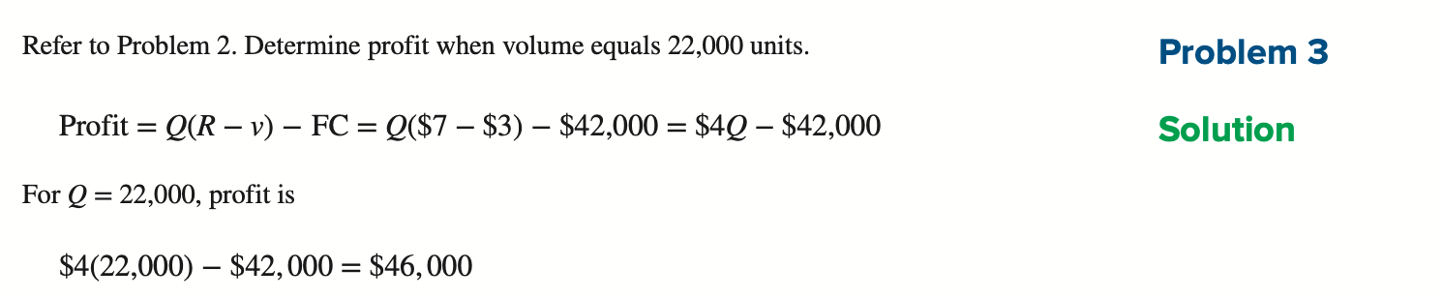

Slide 47
Sample Practice#1
A small firm intends to increase the capacity of a bottleneck operation by adding a new machine.
The annual fixed cost would be Tk. 42,000/-, variable cost per unit would be Tk. 15/- and revenue per unit would be Tk. 22/-.
Write down the cost, revenue, and profit function.
What annual volume is required to break even?
What would be the profit if 5,000 units were made?
How many units must be sold to realize a profit of Tk. 7,000/-?
1000 units can be sold and profit target is Tk. 4,000/-,
what price should be charged per unit?

Slide 48
Sample Practice#1 (Contd.)
(i) No of units produced and sold = q
Cost Function, C(q) = FC+VC
= 42,000+15q
Revenue Function, R(q) = 22q
Profit function P(q) = R-C= 22q – (42,000 + 15q)
= 22q – 42,000 – 15q
= 7q – 42,000

Slide 49
Sample Practice#1 (Contd.)
(ii) For break even, R=C
Q_{BEP} = FC/R-V
= 42,000/22 - 15
= 6,000 units
(iii) P = Q (R-V) - FC
= 5,000 (22-15) – 42,000
= 5,000 (7) – 42,000 = 35,000 – 42,000 = -7,000
if 5,000 units are sold there will be no profit rather loss of Tk. 7,000/-

Slide 50
Sample Practice#1 (Contd.)
(iv) Q = P + FC
R−v
= 7,000+42,000
22-15
= 49,000
7
Q = 7,000 units
To make a profit of Tk. 7,000/-, 7,000 units must be sold.
(v) Given, Q=1000 units and Profit, P= Tk. 4,000/-
P = Q (R − v) − FC
4000=1000(R -15) – 42000
4000= 1000R – 15000 – 42000 = 1000R= 4000+57000
R= 61000/1000 R= Tk. 61
To sell 1000 units and to make a profit of Tk. 4,000/-, the selling price per unit must be Tk. 61/-.

Slide 51
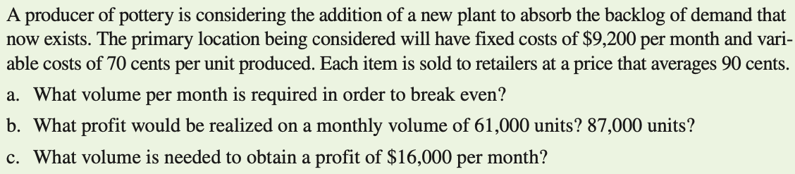
Sample Practice#2

Slide 52
Sample Practice#2
(a) Here, FC= $9,200 per month, v= $ 0.70 and R = $0.90
Q_{BEP} = FC/R-V
= 9,200/0.90-0.70
= 46,000 units per month
(b) P = Q (R-V) - FC
= 61000 (0.90-0.70) – 9,200
=$ 3,000 per month
(b) P = Q (R-V) - FC
= 87,000 (0.90-0.70) – 9,200
=$ 8,200/-

Slide 53
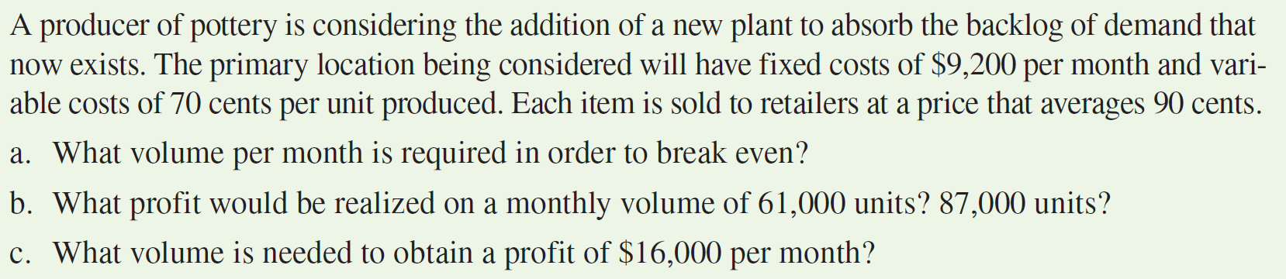
Sample Practice#2
(c) Q = P + FC
R−v
Q = 16,000+9,200
0.9-0.7
Q = 25,200/0.2 = 126,000 units
In order to make a profit of $16,000/- per month, 126,000 units must be sold.

Slide 54
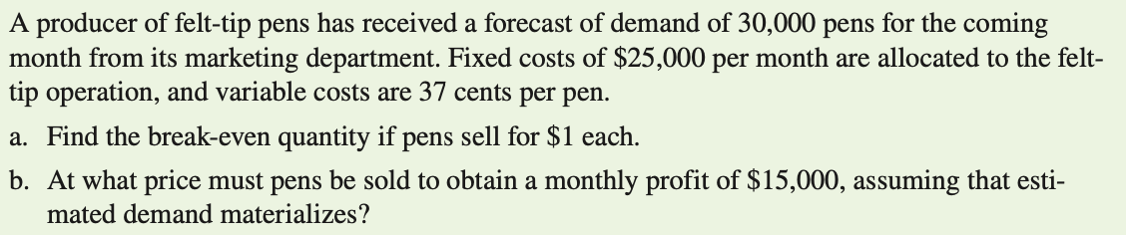
Sample Practice#3

Slide 55
Sample Practice#3 (Contd.)
(i) For break even, R=C
Q_{BEP} = FC/R-V
= 25000/1 – 0.37
= 39,683 pens
(ii) Given, Q=30000 units and Profit, P= $15,000/-
P = Q (R − v) − FC
15,000=30,000(R -0.37) – 25,000
15,000= 30000R – 11,100 – 25,000
30,000R= 15,000+36,100
R= 51,100/30000 R= $1.71
To sell 30,000 pens, the company needs to sell at $1.71/- to make a profit of $15,000/-.

Slide 56

Sample Practice#4
Haripur Power Plant procures electricity.
Design capacity= 360 MW
Effective Capacity= 340 MW
Actual Output= 330 MW
Compute Efficiency and Utilization.
Efficiency = $\frac{Actual Output}{Effective Capacity}= \frac{330}{340}\text{×}100\%=97.06\%$
Utilization = $\frac{Actual Output}{Design Capacity}= \frac{330}{360}\text{×}100\%=91.67\%$

Slide 57
Sample Practice#5
A company produces 5 different types of product.
Product: A Annual demand: 400 units Processing time per unit: 3 hours
Product: B Annual demand: 370 units Processing time per unit: 2 hours
Product: C Annual demand: 430 units Processing time per unit: 8 hours
Product: D Annual demand: 200 units Processing time per unit: 5 hours
Product: E Annual demand: 600 units Processing time per unit: 10 hours
Machine annual capacity is 3500 hrs.
How many Machines/ equipment will be needed to meet the annual demand for these 5 products?

Slide 58

Sample Practice#5 (Contd.)
Solution:
Total processing time for Product A: 400 × 3= 1200 hours
Total processing time for Product B: 370 × 2= 740 hours
Total processing time for Product C: 430 × 8= 3440 hours
Total processing time for Product D: 200 × 5= 1000 hours
Total processing time for Product E: 600 × 10= 6000 hours
No of machines required= $\frac{Total Processing time}{Annual Capacity of the machine}$
$=\frac{1200+740+3440+1000+6000}{3500}$= 3.54 = 4 machines

Slide 59
END OF THE CHAPTER…

